Slide 1
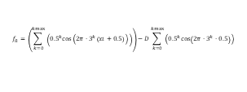
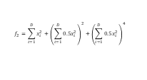

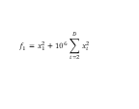
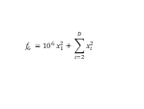
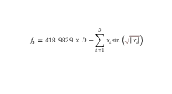
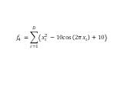
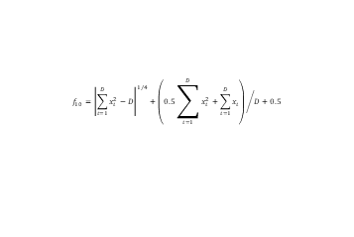
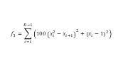
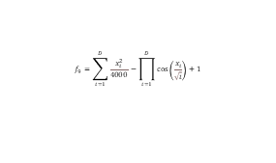
$$f_{1}=x_{1}^{2}+{10}^{6}\sum_{i=2}^{D}{x_{i}^{2}}$$
$$f_{2}=\sum_{i=1}^{D}{x_{i}^{2}}+{\left(\sum_{i=1}^{D}{0.5x_{i}^{2}}\right)}^{2}+{\left(\sum_{i=1}^{D}{0.5x_{i}^{2}}\right)}^{4}$$
$$f_{3}=\sum_{i=1}^{D−1}{\left(100{\left(x_{i}^{2}−x_{i+1}\right)}^{2}+{\left(x_{i}−1\right)}^{2}\right)}$$
$$f_{4}=\sum_{i=1}^{D}{\left(x_{i}^{2}−10cos\left(2πx_{i}\right)+10\right)}$$
$$f_{5}=418.9829×D−\sum_{i=1}^{D}{x_{i}sin\left(\sqrt{\left|x_{i}\right|}\right)}$$
$$f_{6}={10}^{6}x_{1}^{2}+\sum_{i=2}^{D}{x_{i}^{2}}$$
$$f_{7}=20−20e^{−0.2\sqrt{\frac{1}{n}∗\sum{x_{i}^{2}}}}+e−e^{\frac{1}{n}\sum{cos\left(2πx_{i}\right)}}$$
$$f_{8}=\left(\sum_{k=0}^{kmax}{\left({0.5}^{k}cos\left(2π⋅3^{k}\left(xi+0.5\right)\right)\right)}\right)−D\sum_{k=0}^{kmax}{\left({0.5}^{k}cos\left(2π⋅3^{k}⋅0.5\right)\right)}$$
$$f_{9}=\sum_{i=1}^{D}{\frac{x_{i}^{2}}{4000}}−\prod_{i=1}^{D}{cos\left(\frac{x_{i}}{\sqrt{i}}\right)}+1$$
$$f_{10}={\left|\sum_{i=1}^{D}{x_{i}^{2}−D}\right|}^{1/4}+{\left(0.5\sum_{i=1}^{D}{x_{i}^{2}+\sum_{i=1}^{D}{x_{i}}}\right)}/D+0.5$$

Slide 2
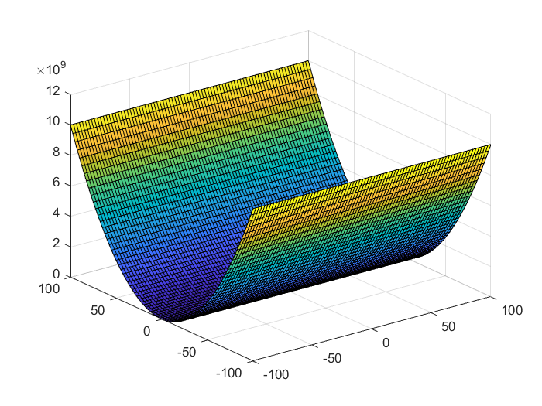
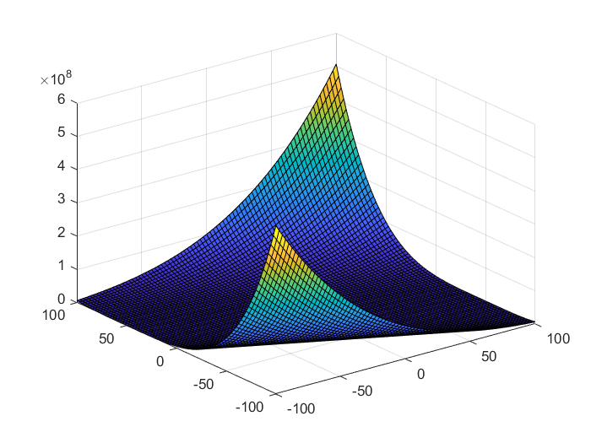
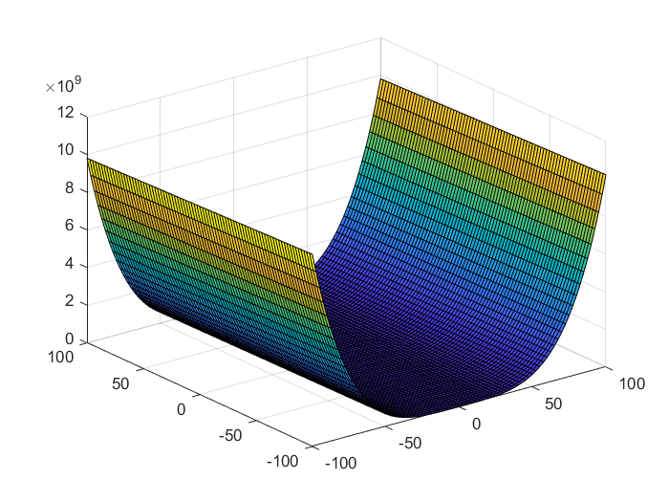
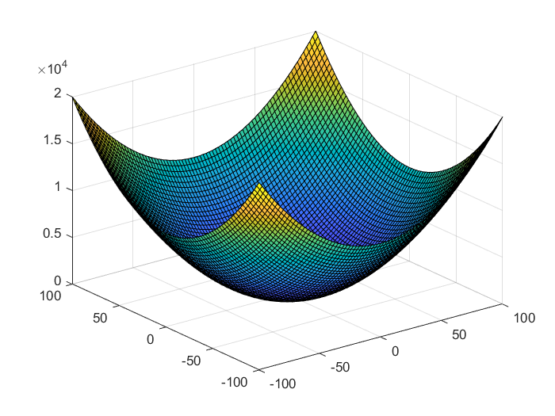
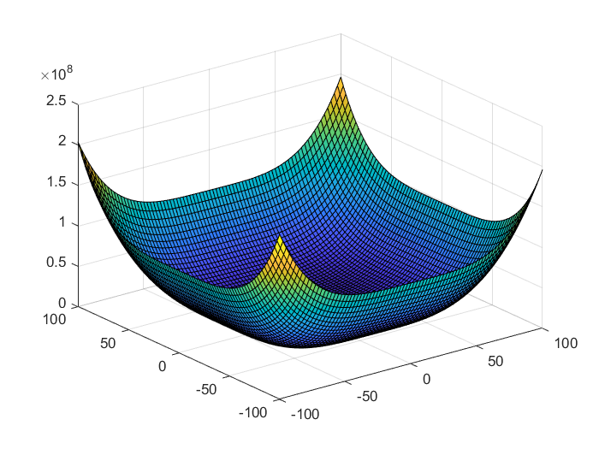
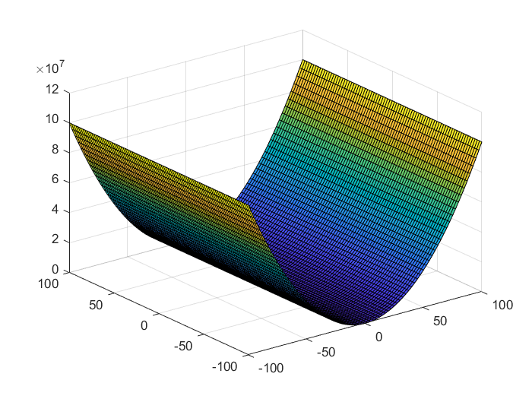
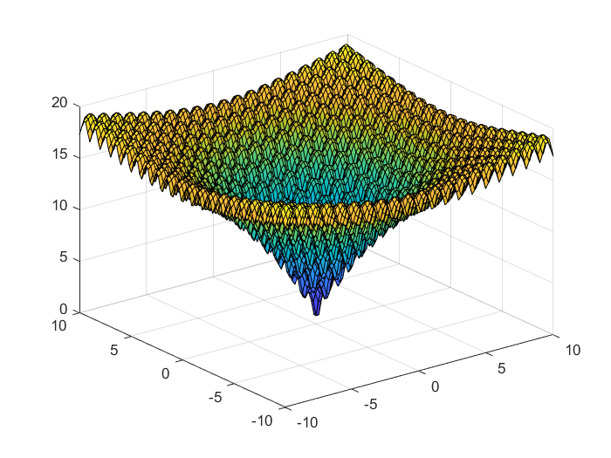
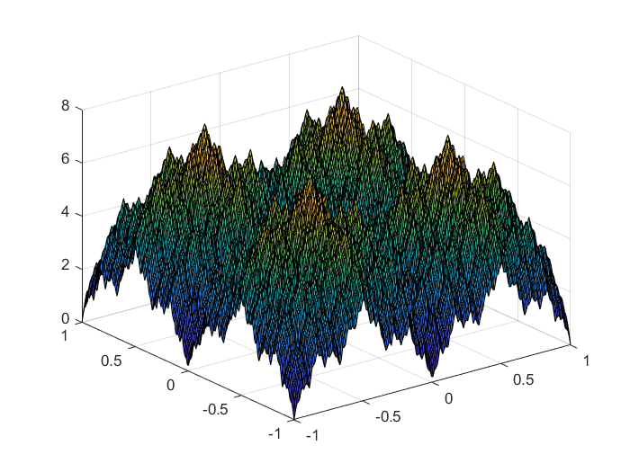
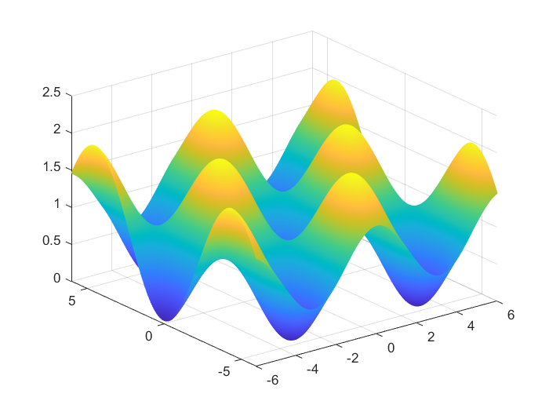
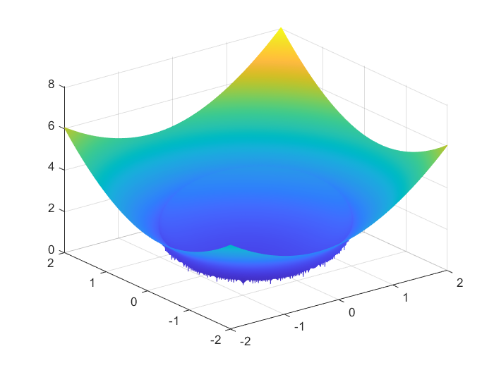
(a) f₁
(b) f₂
(c) f₃
(d) f₄
(e) f₅
(f) f₆
(g) f₇
(h) f₈
(i) f₉
(j) f₁₀
Fig. 3. Test function in its search space and near the extreme point image

Slide 3
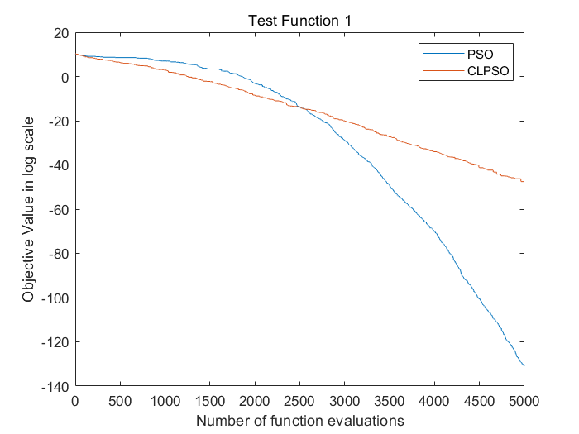
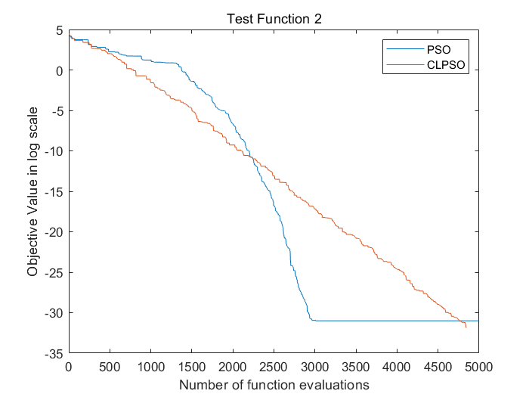
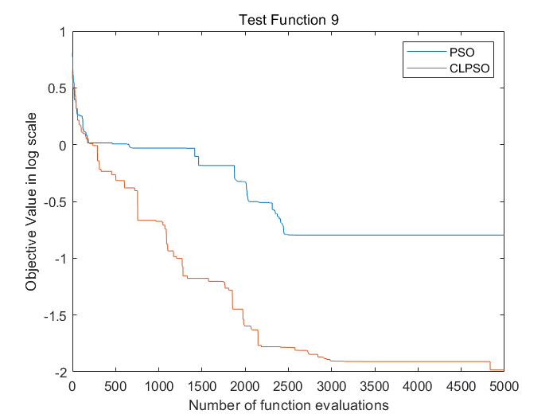
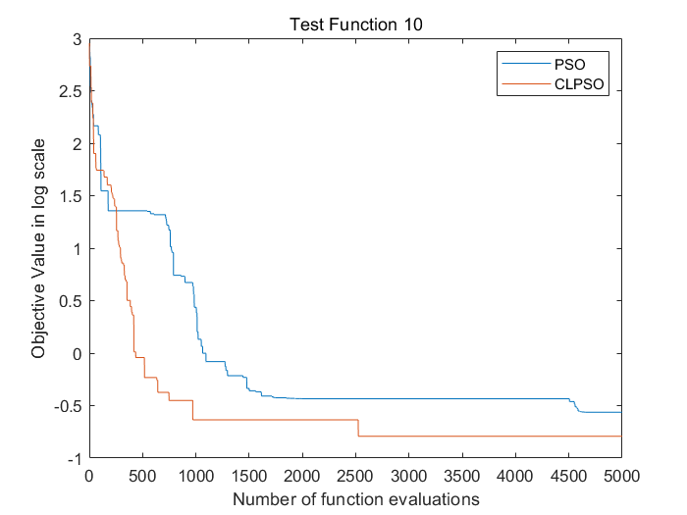
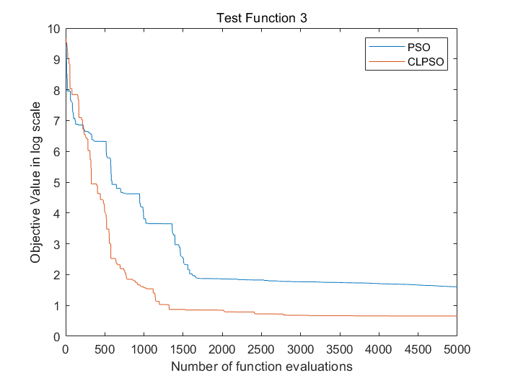
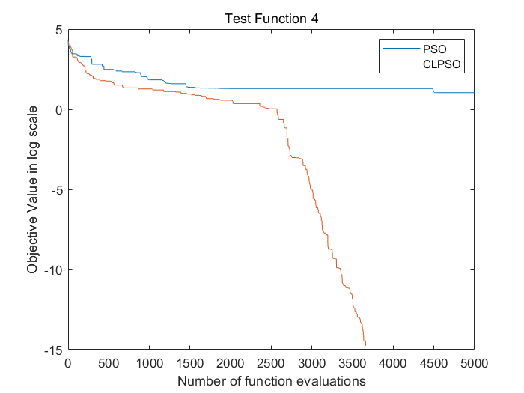
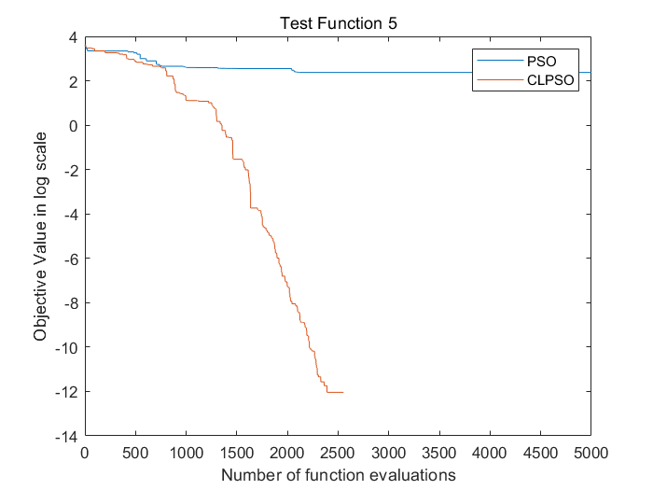
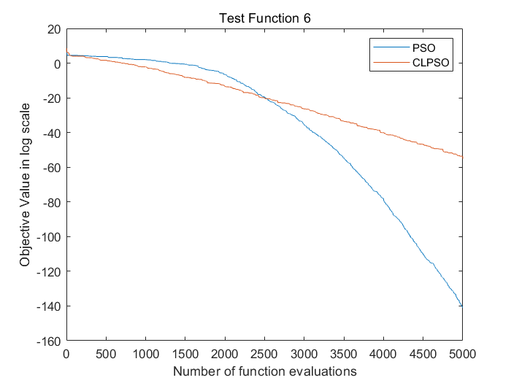
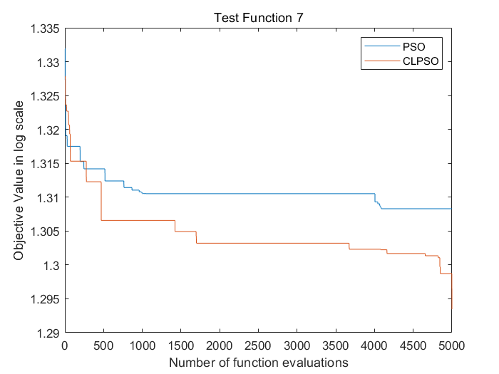
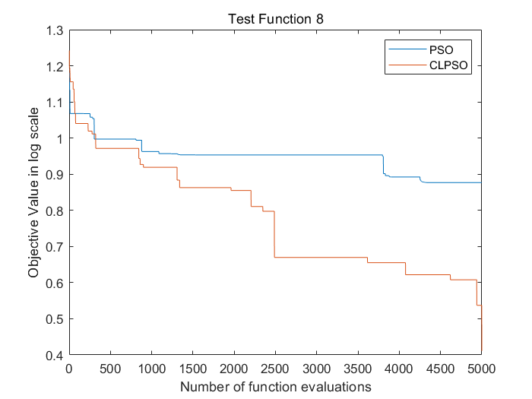
(a) f₁
(b) f₂
(c) f₃
(d) f₄
(e) f₅
(f) f₆
(g) f₇
(h) f₈

Slide 4

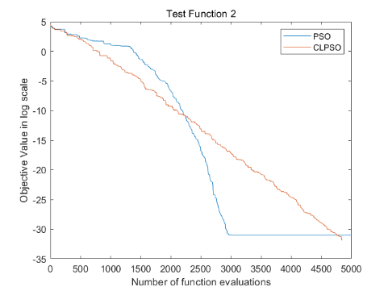
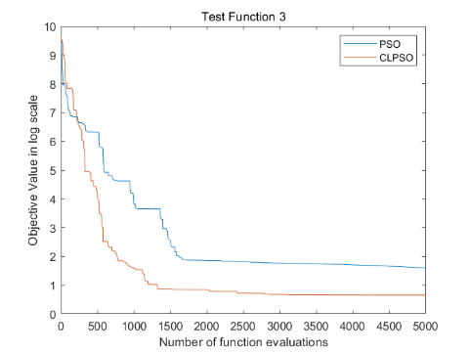
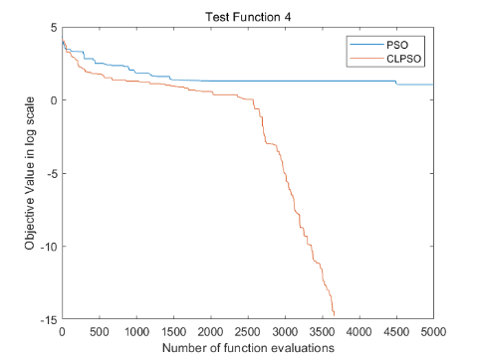
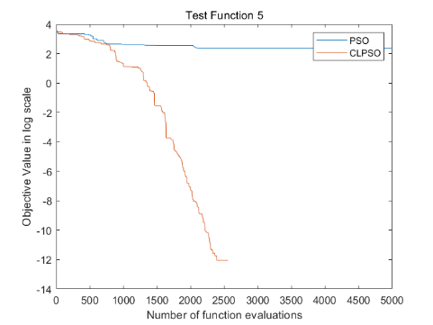
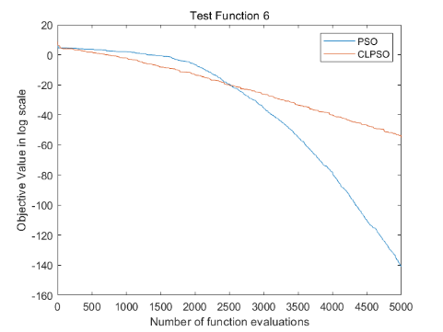
(a) f₁
(b) f₂
(g) f₇
(h) f₈
(c) f₃
(d) f₄
(i) f₉
(j) f₁₀
(e) f₅
(f) f₆

